Slide 1

Module 2- Big Data Infrastructure
Hadoop Ecosystem-HBase

Slide 2

Hadoop Ecosystem-HBase
Review of Sterday…..
HDFS good for batch processing not really make up a good database.
Limitations
Record lookup not possible
Specific field in a table
Hbase/Cassandra
Data Model is Columnar store
BigTable Data Model

Slide 3

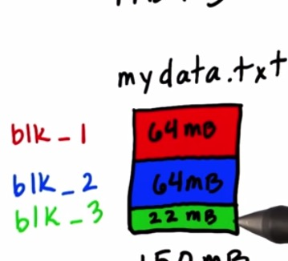

Hadoop Ecosystem-HBase
When to use What?
HDFS
HIVE
Unstructured data
Read completely
No Updates
Structured Data
SQL Analytics
HBASE
Unstructured Data
Arbitrary writes
Analytics

Slide 4
Hadoop Ecosystem-HBase
Exercise
Which of these could be stored in HDFS, Hive or Hbase?
1. Parsed transaction logs of user activity in a website where relevant fields from the log have been extracted
2. Unparsed transaction logs of user activity
3. Database of users and friends at a social website, which is periodically analyzed for social networking analysis

Slide 5
Hbase Data Model

Slide 6
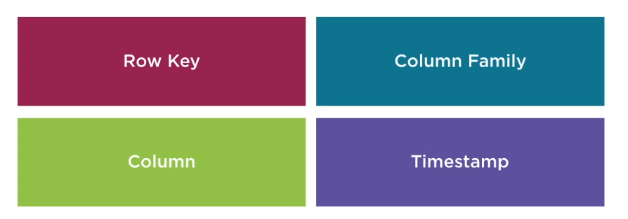
Hadoop Ecosystem
Not 2 Dimensional

Slide 7
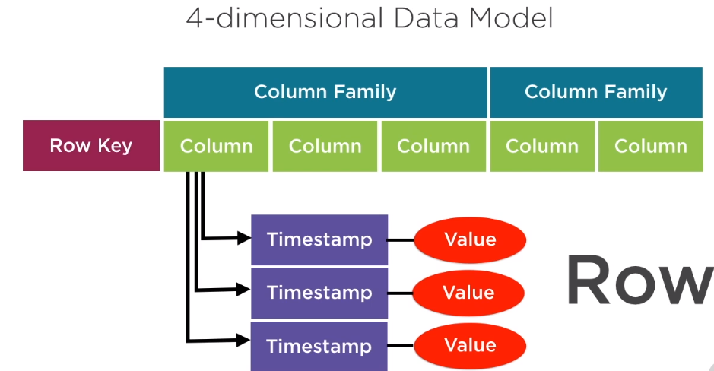
Hadoop Ecosystem
4 Dimensional Data Model

Slide 8
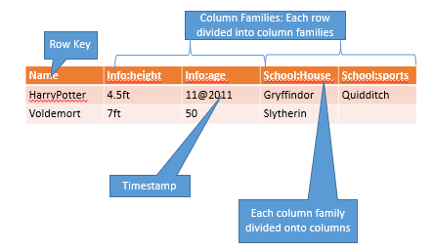
Hadoop Ecosystem
4 Dimensional Data Model

Slide 9
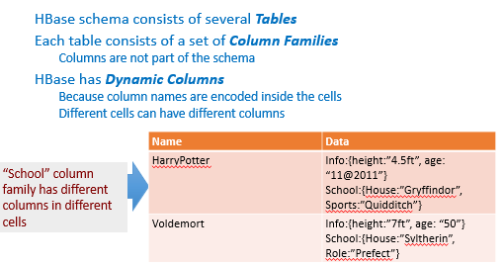
Hadoop Ecosystem
4 Dimensional Data Model

Slide 10
Hbase Architecture
Notes:
Exercise
Write a similar program for
Finding the words in a file
For each word, calculate the count
Assume the file contains the string
“To be or not to be”
Hint
This should be done in parallel
In the blue boxes, read in each line in the file
If the line is w1 w2 w3 w4, then output 4 lines w1 1 w2 1 w3 1 w4 1

Slide 11
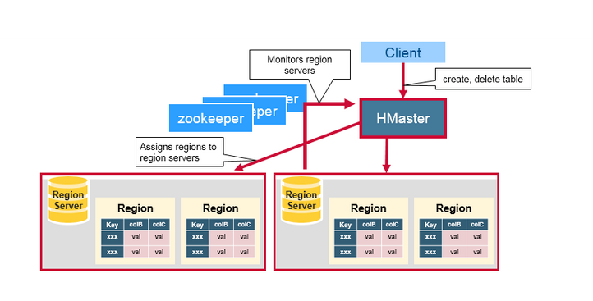
BIG DATA
Hbase Architecture – Master Slave
Region
A subset of a table’s rows, like horizontal range partitioning
Automatically done
RegionServer (many slaves)
Manages data regions
Serves data for reads and writes (using a log)
Master
Responsible for coordinating the slaves
Assigns regions, detects failures
Admin functions
Like datanode of HDFS
Line namenode of HDFS
Refer https://www.mapr.com/blog/in-depth-look-hbase-architecture

Slide 12
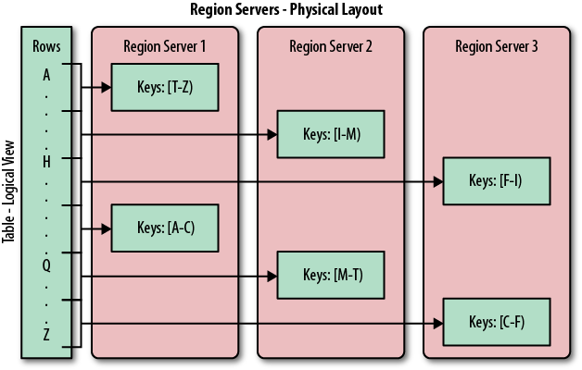
BIG DATA
Regions and region servers
Tables horizontally partitioned into regions
Regions stored on region servers
Start with a single region and then master monitors load and splits into multiple regions
META Table: keeps track of regions
Refer https://www.mapr.com/blog/in-depth-look-hbase-architecture

Slide 13
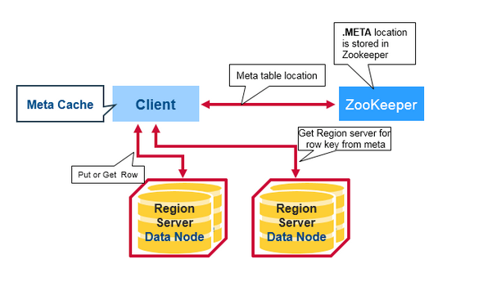
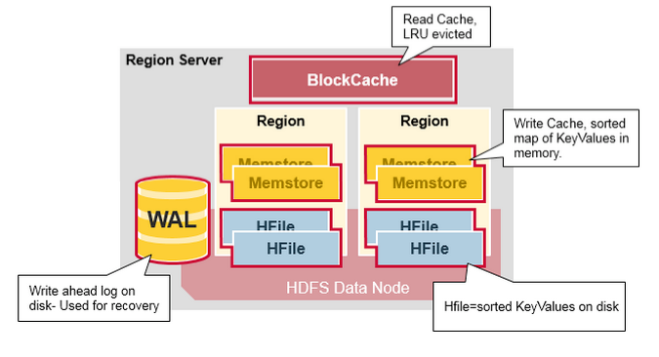
BIG DATA
Read/Write Operation
Refer https://www.mapr.com/blog/in-depth-look-hbase-architecture

Slide 14
Cassandra Architecture

Slide 15
BIG DATA
Cassandra Architecture – peer to peer architecture
Differences from Hbase
Request coordination over a partitioned dataset – no Master
Ring membership and failure detection – no Master
Local persistence (storage) engine – does not rely on HDFS
Cqlsh – for performing queries
Refer https://www.mapr.com/blog/in-depth-look-hbase-architecture

Slide 16
BIG DATA
Some Ways to Access HBASE
Hbase Shell
Java API
Wrappers for Python,Scala,etc
Spark,Hive,Pig
REST service
Thrift Service
Avro Service

Slide 17
Installation of HBase

Slide 18
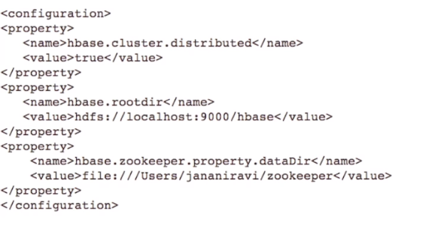
Hadoop Ecosystem
Setting the configuration

Slide 19

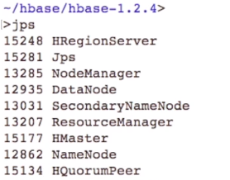
Hadoop Ecosystem
Checking HBase

Slide 20
Hbase usage
Notes:
Exercise
Write a similar program for
Finding the words in a file
For each word, calculate the count
Assume the file contains the string
“To be or not to be”
Hint
This should be done in parallel
In the blue boxes, read in each line in the file
If the line is w1 w2 w3 w4, then output 4 lines w1 1 w2 1 w3 1 w4 1

Slide 21
BIG DATA
Hbase: Creating a new table
Column family name
Table name

Slide 22
BIG DATA
Hbase inserting data
Row key
Column name
Value

Slide 23
BIG DATA
Hbase: retrieving data
Getting a specific row
All rows

Slide 24
CRUD Operations Using HBase

Slide 25
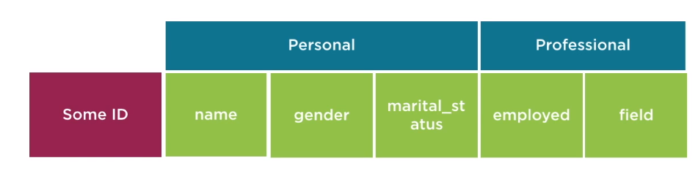
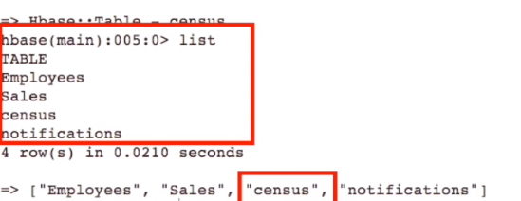

BIG DATA
Hbase: Creation

Slide 26
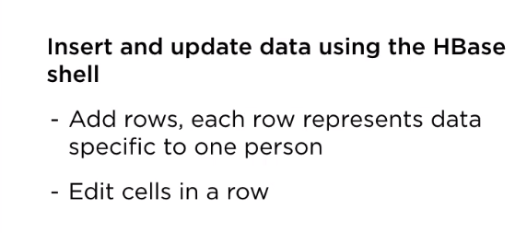
BIG DATA
Hbase: Creation

Slide 27
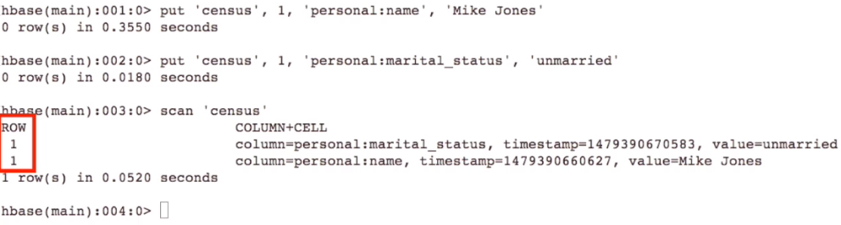
BIG DATA
Hbase: Insertion

Slide 28
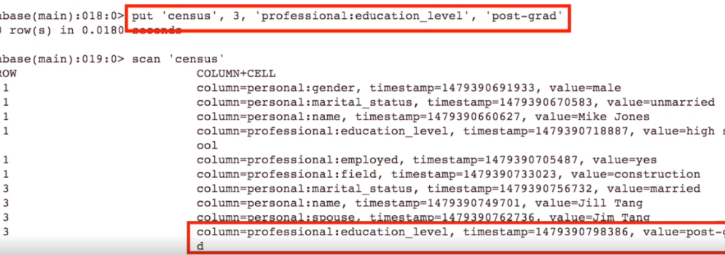
BIG DATA
Hbase: Insertion

Slide 29
BIG DATA
Hbase: Insertion

Slide 30
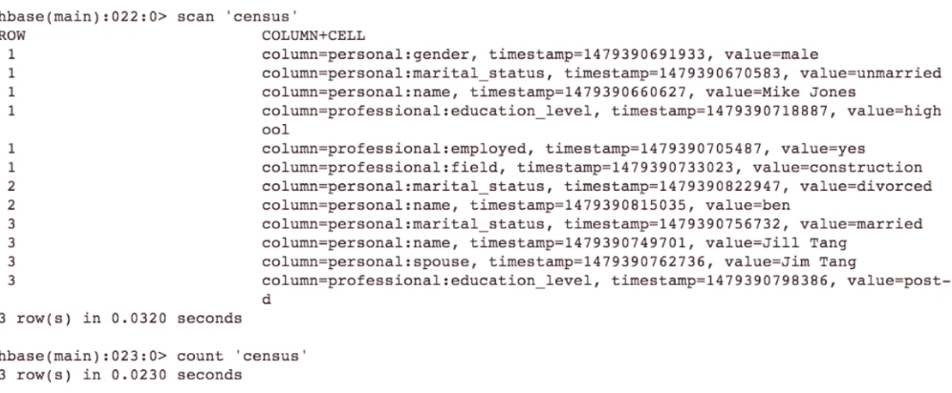
BIG DATA
Hbase: Insertion

Slide 31
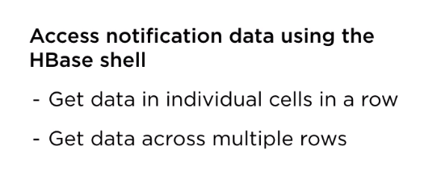
BIG DATA
Hbase: Get

Slide 32
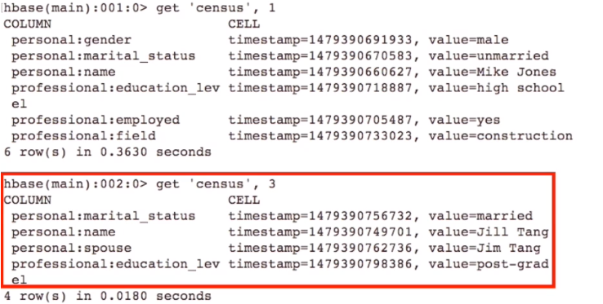
BIG DATA
Hbase: Get

Slide 33

BIG DATA
Hbase: Retrieve Data from specific row

Slide 34
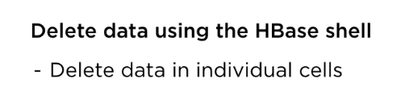
BIG DATA
Hbase: Delete Data

Slide 35
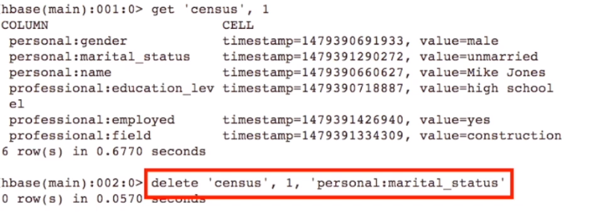
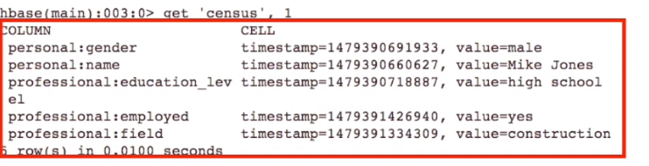
BIG DATA
Hbase: Delete Data

Slide 36
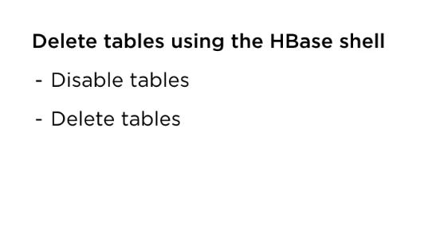
BIG DATA
Hbase: Delete Data

Slide 37
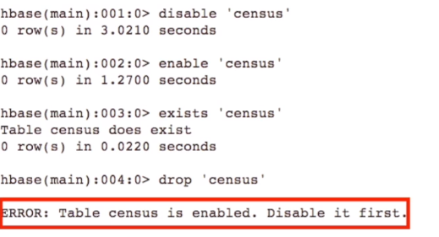
BIG DATA
Hbase: Delete Data

Slide 38

BIG DATA
Explore further in Hbase
Executing Hbase CRUD operations using Java API
Based on Conditions filtering rows
Integrating Map Reduce with HBase

Slide 39
THANK YOU
“WORLD IS ONE BIG DATA PROBLEM”
“TORTURE THE DATA AND IT WILL CONFESS TO ANYTHING”

